Slide 1
PSG Monthly Report September 2024

Slide 2
Agenda
Ticket status
Ticket per pillar
Ticket per engineer
Ticket summary
Satisfaction rating
Projects
Trainings

Slide 3
Ticket Status
Total: 641

Slide 4
Tickets per Pillar
Total: 641

Slide 5
Data Center
Total: 119
Notes:
NUTANIX – Accralaw (Project), Personal Collection (POC collab with Mtech)
SOLARWINDS – FMIC,(FOR KT) Aventus (NO SCHED for Upgrade SEM, Intellicare
VERITAS – SEMIRARA – Upgrade
ACRONIS – Leadence, DDB
RUBRIK - SMIC

Slide 6
IT Security
Total: 116
Notes:
FORTINET – LTP, Accralaw, SMC Skyway, VVS,Orix, Sodexo,Man Energy, Wallem Maritime Services
SOPHOS – Bangko kabayan, Diwa Learning, FMIC, iAcademy,PhilCare
CHECKPOINT – OONA, Microtel, Hospitality Innovators,Mapua, Asalus
RUCKUS – multiple products

Slide 7
Network Infrastructure
Total: 371
Notes:
VERSA – Metrobank, AUB
HP Aruba – PAL, Accralaw, Personal Collection, 2GO
CISCO – Intellicare, Pluxee,Mapua, iScan,Standard Insurance, Metro Hue

Slide 8
Unified Communications
Total: 34
Notes:
SHORETEL/MITEL – Mapua Intra, Ateneo De NAGA, Cebu Pacific,SMC Skyway

Slide 9
Tickets per Engineer

Slide 10
Andrea Cus
Revenue generating
Non-revenue generating
Per product
Notes:
MA – Oona, Mapua, iScan, MCL, Asalus, Microtel
PROJECT – Metrobank (VERSA)
POC- Hospitality Innovators (collab)
SITE SURVEY-Hospitality Innovators

Slide 11

Arvin Mathew Paguinto
Revenue generating
Non-revenue generating
Per product
Notes:
Project – Accralaw, FMIC,SMIC

Slide 12
Bernadette De Sagun
Revenue generating
Non-revenue generating
Per product
Notes:
Project- cisco esa/sma ut global

Slide 13
Estiphanie Frio
Revenue generating
Non-revenue generating
Per product

Slide 14
Grace Jhon Rada
Revenue generating
Non-revenue generating
Per product
Notes:
PROJECT – Diwa Learning, Accralaw, 2G0, AUB, SMC Skyway, PAL
SMC (JUNIPER)
DIWA LEARNING; BANGKO KABAYAN (SOPHOS)

Slide 15
Jaime Gabuyo Jr.
Revenue generating
Non-revenue generating
Per product
Notes:
Project – harbor start, bpoi

Slide 16
Joemari Rubiano
Revenue generating
Non-revenue generating
Per product
Notes:
PROJECT – Intellicare (cisco switch), Metrobank
MA – Sem calaca,Microtel,Malayan,iScan, Asalus
BreakFix – Standard insurance –Cisco Switch

Slide 17
John Vincent Seno
Revenue generating
Non-revenue generating
Per product

Slide 18
Kenneth Baylon
Revenue generating
Non-revenue generating
Per product
Notes:
Poc – collab ardent lufthansa

Slide 19
Marjo Buenaobra – 27/6/21
Per product
Revenue generating
Non-revenue generating
Notes:
Project – solarwinds phinma

Slide 20
Oliver Paulite – 40/36/4
Per product
Revenue generating
Non-revenue generating
Notes:
Project - aub, cebu air, leadence

Slide 21
Rodolfo Osias – 40/22/18
Per product
Revenue generating
Non-revenue generating
Notes:
Warranty claim – ateneo de naga

Slide 22
Romulo Rosana Jr. – 49/39/10
Per product
Revenue generating
Non-revenue generating
Notes:
Poc – collab enshored, metrobank hp aruba

Slide 23
Soothettes Bonagua – 9/3/6
Per product
Revenue generating
Non-revenue generating

Slide 24
Vhincent Paul Mercado – 34/29/5
Per product
Revenue generating
Non-revenue generating
Notes:
Poc – mapua, gsis
Project – cebu air Sophos, pacific union

Slide 25
PSG Ticket Summary

Slide 26
Service type

Slide 27
JO Satisfaction Rating

Slide 28
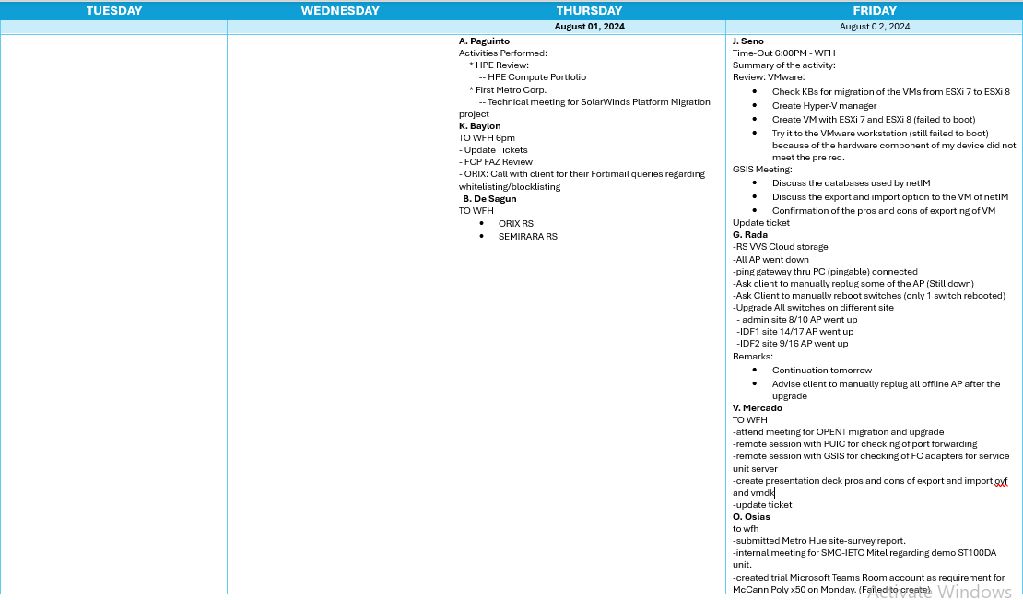

Slide 29
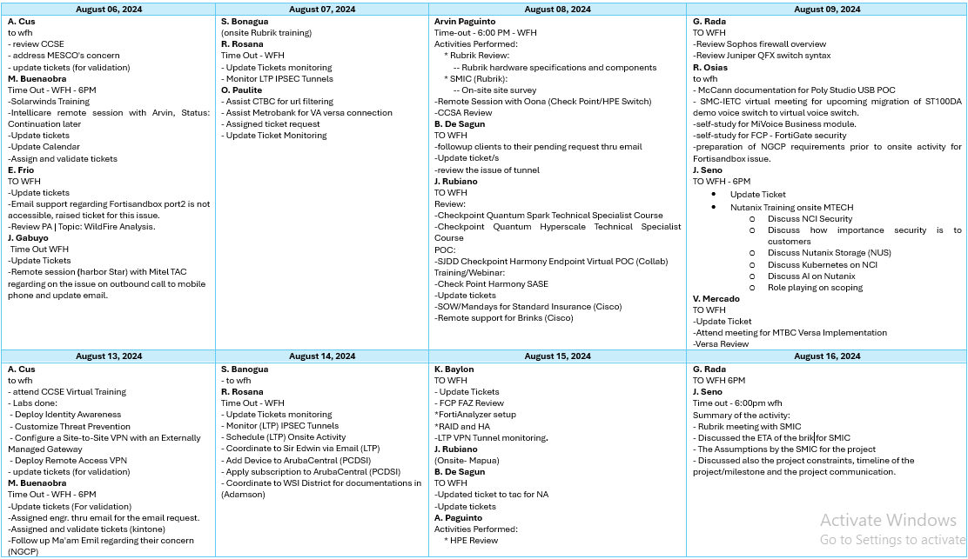

Slide 30
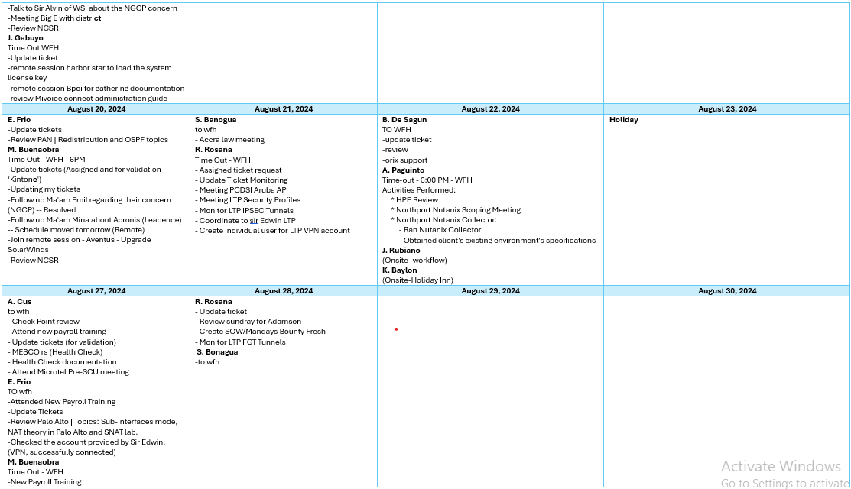

Slide 31
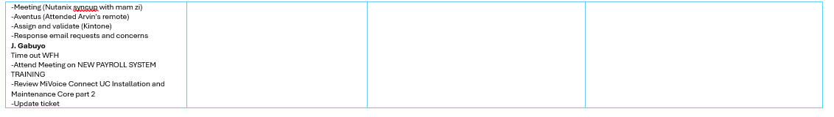

Slide 32
Target Certifications
Romulo Rosana Jr.
Target Certification: FortiAnalyzer
Deadline: TBD
Kenneth Baylon
Target Certification: Forti Analyzer
Deadline: September 27, 2024
Andrea Cus
Target Certification: Checkpoint R81.20 CCSE (Checkpoint Certified Security Expert)
Deadline: TBD

Slide 33
Certifications Taken
Arvin Mathew Paguinto
Target Certification: HPE0-V25-HPE Hybrid Cloud Solutions
Status: Passed

Slide 34
Projects
Engineer | Product | Client | Start | End | Status | Remarks
G. J. Rada | HP Aruba | Philippine Airlines | 05/25/24 |  | On going | Pending installation of transceivers, to be scheduled next week
B. De Sagun | Forti Firewall / Forti Switch | Lufthansa Teknik | 09/18/23 |  | On going | Pending documentation
J. Gabuyo | Poly | Bangko Sentral | 08/19/24 | 08/19/24 | Completed | System acceptance signed
A. Paguinto | Solarwinds DPA | Aventus | 08/09/24 | 09/05/24 | On going | System acceptance signed as of September 5, 2024
A. Paguinto | Solarwinds DPA | FMIC | 08/16/24 |  | On going | Waiting for client’s advice regarding the consolidation of hosts to be added
V. Mercado | Sophos Firewall | Pacific Union | 07/30/24 |  | On going | System acceptance signed as of September 25, 2024
Notes:
Ngcp – cebu Kenneth, cdo Romulo, blrcc vst
Phinma – march 7 sent email, follow up 03/18/24

Slide 35
Trainings
Product | Description | Engineer/s | Start | End | Status | Certification | Remarks
Rubrik | Enablement | A. Paguinto, M. Buenaobra, J. Seno, S. Bonagua | 08/07/24 | 08/07/24 | Completed
Check Point | CCSE Training | A. Cus | 08/12/24 | 08/14/24 | Completed
Trend Micro | Training | R. Rosana, K. Baylon | 08/06/24 |  | On going
Cisco | Training | J. Rubiano, V. Mercado | 08/20/24 | 08/20/24 | Completed
HP Aruba SASE | Training | K. Baylon, G. Rada | 08/13/24 | 08/14/24 | Completed
Notes:
Ngcp – cebu Kenneth, cdo Romulo, blrcc vst
Phinma – march 7 sent email, follow up 03/18/24

Slide 36
Revenue on Projects
CLIENT | BRAND | PRODUCT | SR No. | SERVICE COST
Bangko Sentral ng Pilipinas | Poly | Poly Studio USB Video Bar | 56949 | 3,500
Aventus Medical Care Inc. | Solarwinds | DPA | 57052 | 52,500
FMIC | Solarwinds | DPA | 57274 | 30,000
Metrobank | Versa | Versa 1300/355 | 56805 | 1,000,000
 |  |  | Total Cost | P1,086,000

Slide 37
Pride is concerned with who is right. Humility is concerned with what is right. Humility is not thinking less of yourself, it’s thinking of yourself less.

Slide 38
Thank you!

